Slide 1


Group 4
Mehak Khurram 22L-7956
Areeba Mujahid 22L-7864
Aneeza Junaid 22L-7903
Takreem Jaffery 22L-7949

Slide 2
“Quality is important, but brands are not built by quality alone.”
Law of Quality
What’s your favourite brands based on quality?

Slide 3


Success in market place
has no correlation to
success in comparative
brand testing
-Taste tests, accuracy tests, reliability tests, durability tests, etc.

Slide 4
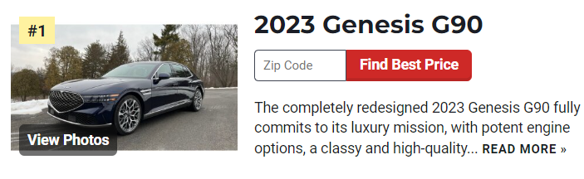
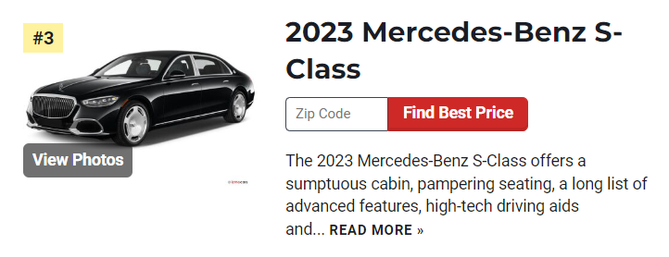
sales =1,090
sales =10,122

Slide 5
Does Quality matter? and where?
Quality, or rather the perception of quality, resides in the mind of the buyer. If you want to build a powerful brand, you have to build a powerful perception of quality in the mind.

Slide 6
Best way to build a quality perception
Law of contraction
“A brand becomes stronger when you narrow it’s focus.“
Example
Starbuck-coffee
Subway-submarine sandwitches
Law of expansion
“The power of a brand is inversely proportional to it’s scope.“
Example
Colgate-toothpaste
Colgate-ready made
food

Slide 7
Creating a High-Quality Perception
Having a Better Name
Having a Higher Price

Slide 8

Brand Name
Would you rather become a specialized doctor or a general practitioner?
A specialist is perceived to know more and have “higher quality” than a generalist.
Being a specialist and having a better name go hand in hand. Expanding a brand and being a generalist tend to destroy your ability to select a powerful name.

Slide 9
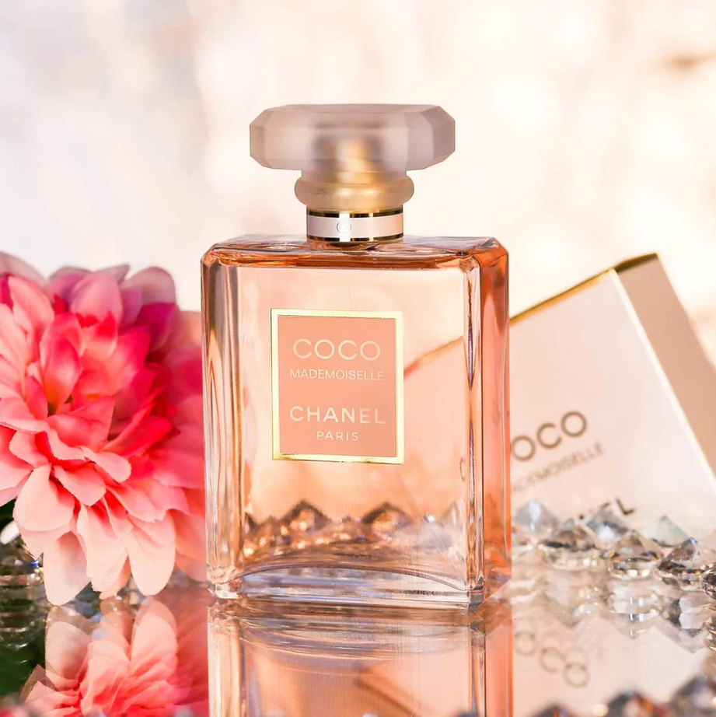
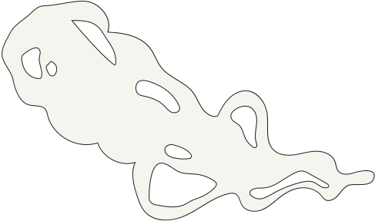

High Price
High price is a benefit to customers.
It allows the affluent customer to obtain psychic satisfaction from the public purchase and consumption of a high-end brand.

Slide 10
A better strategy in a sea of similar products with similar prices is to deliberately start with a higher price.
What can we put into our brand to justify the higher price?

Slide 11
The Law of The Category

Slide 12


A leading brand should promote the category, not the brand.
When you narrow the focus to such a degree that there is no longer any market for the brand, it creates potentially the best situation of all.
Notes:
Slide 1 (Aneeza)

Slide 13
What was the market for expensive cars before Mercedes-Benz?
Almost nothing.
What was the market for electric cars before Tesla? Almost nothing.
What was the market for search engines before Google?
Almost nothing.
What was the market for chaat masala before Shaan Chaat Masala?
Almost nothing.
Notes:
Slide 2

Slide 14
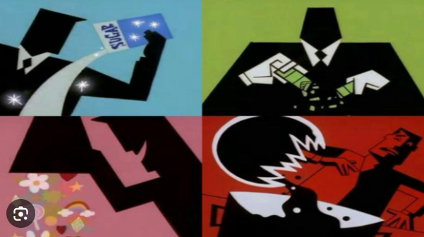
History of Shaan Chaat Masala

Slide 15
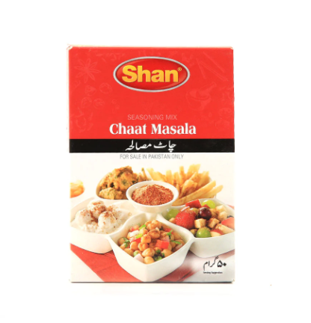
=

Slide 16

The most efficient, most productive, most useful aspect of branding is creating a new category. In other words, narrowing the focus to nothing and starting something totally new.
Notes:
Slide 3

Slide 17
To build a brand in a nonexisting category, to build something out of
nothing, you have to do two things at once:
You have to launch the brand in such a way as to create the perception
that that brand was the first, the leader, the pioneer, or the original.
Invariably, you should use one of these words to describe your brand.
You have to promote the new category.
Notes:
Slide 4

Slide 18
One example of a brand that has been criticized for primarily focusing on self-promotion and neglecting the broader category is Juicero.
Juicero, a now-defunct company, gained attention for its high-tech juicing machine but faced criticism for prioritizing marketing and sleek design over addressing the practicality and necessity of its product within the broader context of the market.

Slide 19
As your new category grows, inevitably competition will come.
And when this happens most brands shift to building their brand instead of promoting the category in fear of losing their position in the lead. This is a mistake. A leader brand should continue to promote the category. And in doing so they could eventually make their brand name stand for that category. This is known as the generic effect.
To illustrate this...
Competition Arrives!

Slide 20
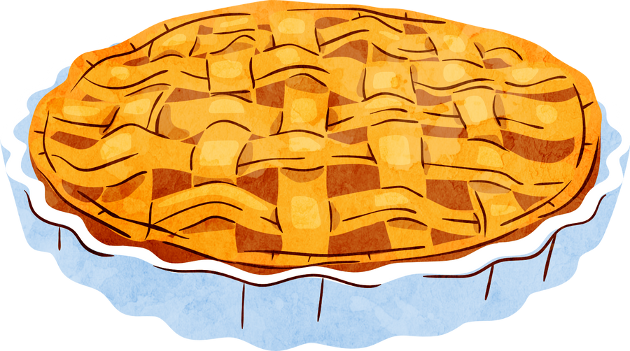
Competitors share
Category
Your share

Slide 21
Your share
Category
Competitors share

Slide 22
Realistically Speaking...
Leading brands of most categories don’t get more than 50% of the share of the market. So rather than fighting competitive brands, a leader should fight competitive categories.
Advantages to having Competition:
The competitive nature of the market and brand wars that occur, stimulate consumers interest in that category. Take for example brands like Pepsi and Coke. Their brand wars expands the consumers interest in the "cola" category.
Getting rid of your competitors is the fastest way to kill the buzz surrounding your brands category.

Slide 23
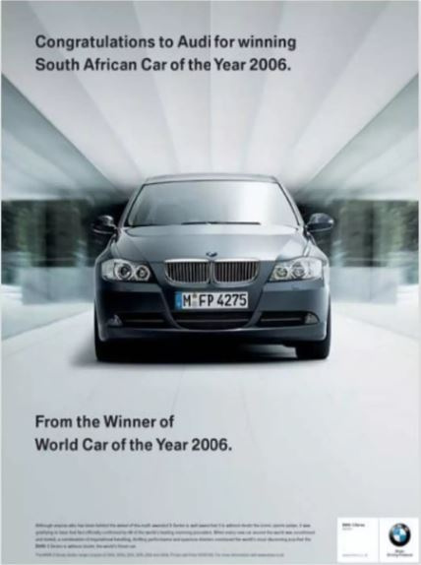

Slide 24
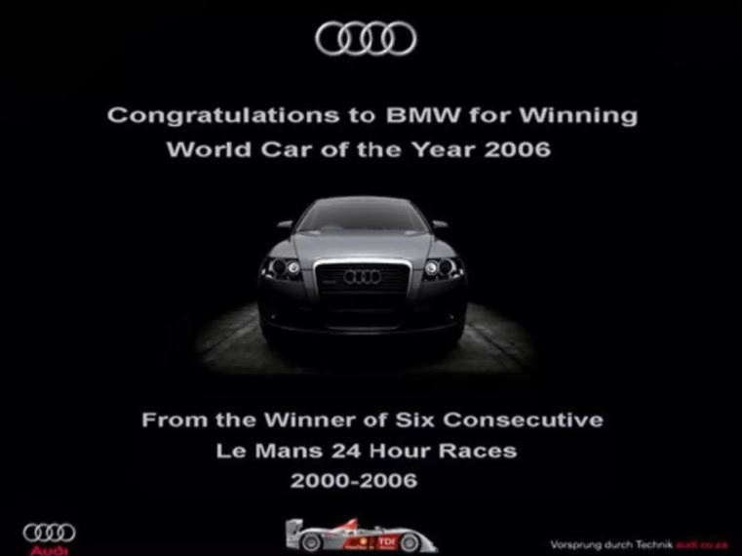

Slide 25
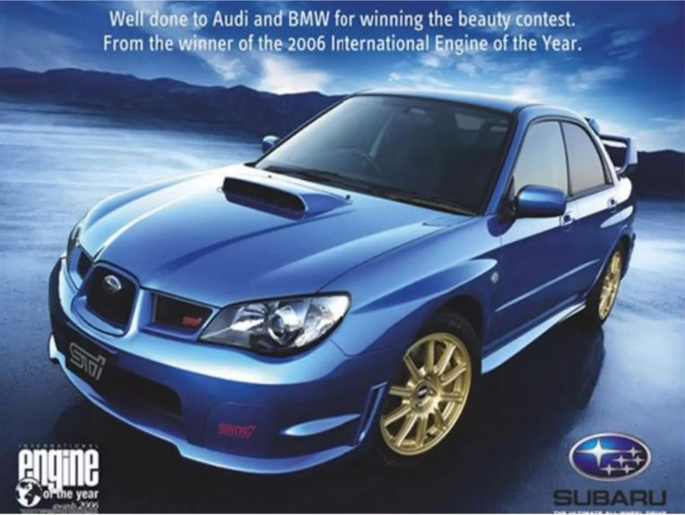

Slide 26
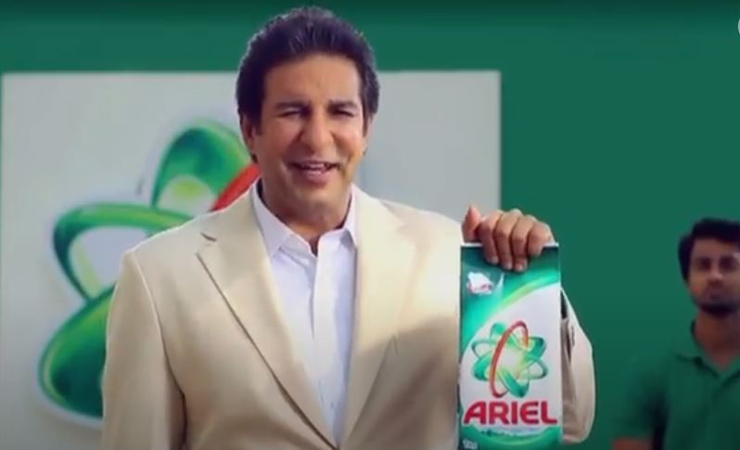

Slide 27

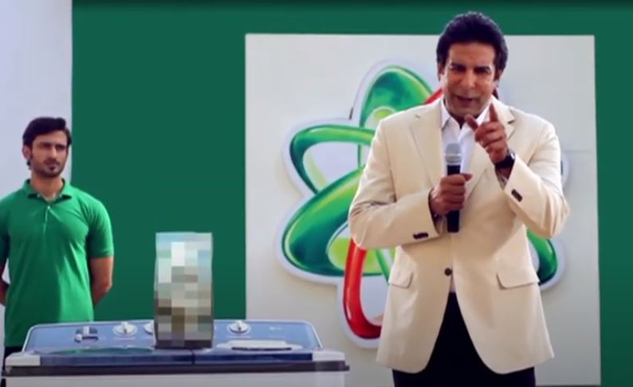
Who could that be?

Slide 28

Who could that be?

Slide 29
In Conclusion:
Quality:
The perception of quality resides in the mind of the buyer. If you want to build a powerful brand, you have to build a powerful perception of quality in the mind. So, use the laws of branding to your advantage, like the law of contraction, and create a better perceived quality.
Category:
According to the law of contraction, a brand becomes stronger when you narrow its focus. So, you should explore and take advantage of the opportunity to introduce a brand-new category, and becoming the leading brand.

Slide 30
Thank You
Any Questions?

